Slide 1
明新科大2023年
上學期GPT(三)

Slide 2
Prompt工程
講師：胡嘉璽
時間：202310月-12月
地點：明新科技大學

Slide 3
課程大綱
Prompt Engineering
專有名詞
Prompt原則及技巧
Completion模式
Chat模式
Insert/Edit模式
Prompt範例

Slide 4
提示語工程
Prompt Engineering
Notes:
https://www.techbang.com/posts/44430-three-laws-of-robotics-is-too-simple-google-ceo-made-ai-ten-principles

Slide 5
Prompt Engineering
從Feature Engineering
到Architecture Engineering
到Objective Engineering
目前是Prompt Engineering

Slide 6
提示語工程
就是向ChatGPT提問時的輸入
這個句子的問法，會影響輸出的品質
如果應用到OpenAI的API上，就不只是和ChatGPT交流，直接和GPT模型交流
利用Instruct Learning和In-Context Learning的問句技巧
這個輸入不見得是自然語言，也可以就是一個向量，而且人看不懂
使用自然語言稱為Hard Prompt，反之稱為Soft Prompt

Slide 7
提示語工程
利用提示語的方式來完成單一下游任務的方法
使用者不需要再微調下游任務
可以用在各種已知下游任務，如Q&A、情感分析、分析、語義標注、指代任務、聊天機器人等

Slide 8
Prompt Injection
模型經過訓練以遵循人為給定的指令來遵循惡意使用者提供的指令
越獄，可能包括要求模特扮演角色，用論點回答，或假裝優於審核指令
提示洩漏，其中使用者說服模型洩露通常對用戶隱藏的提示
Token走私：使用者說服模型洩露通常對用戶隱藏的提示
最有名的就是DAN(Do anything now)，即將ML越獄

Slide 9
提示語工程
Prompt的輸入和輸入字數有限制，GPT3是4000個token，GPT4是8000個
有不同的參數可以設定
好的Prompt有固定的結果
目前提示語工程師在矽谷的年薪是28萬美金到35萬美金之間

Slide 10
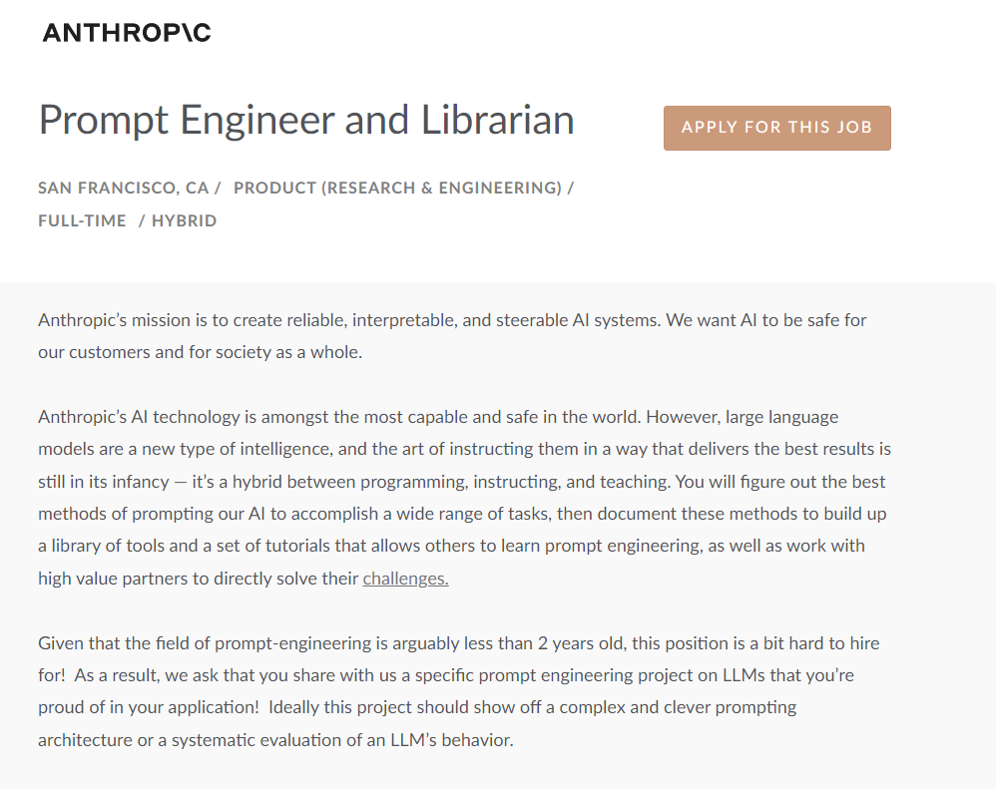
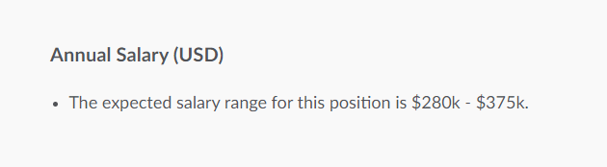

Slide 11
OpenAI API
由OpenAI推出的程式介面，可以直接操作GPT模型，而非單一聊天任務
必須註冊帳號(可以用Gmail)
有多種模型可以選擇，文字模型最強大，另外也有Dall-E的影像模型及Whisper文字轉語音模型
模型要收費，視模型的能力
收費以Token計算，一個中文字為1token，但通常英文是4個字母算1token

Slide 12


Slide 13
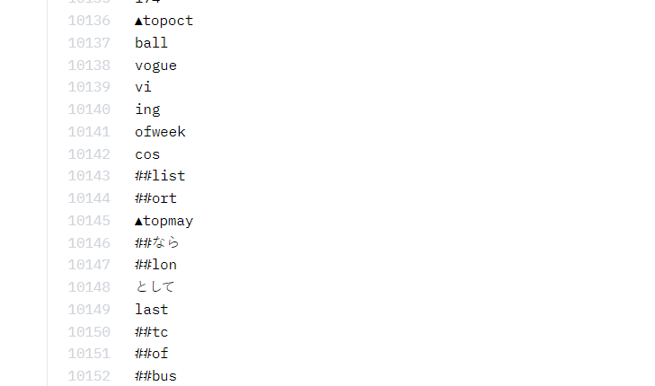
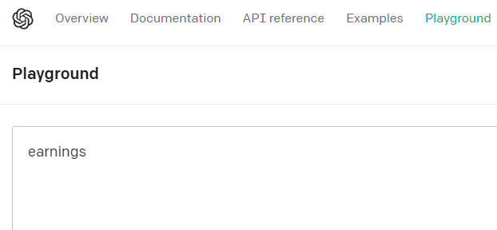
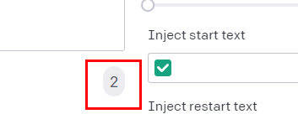

Slide 14
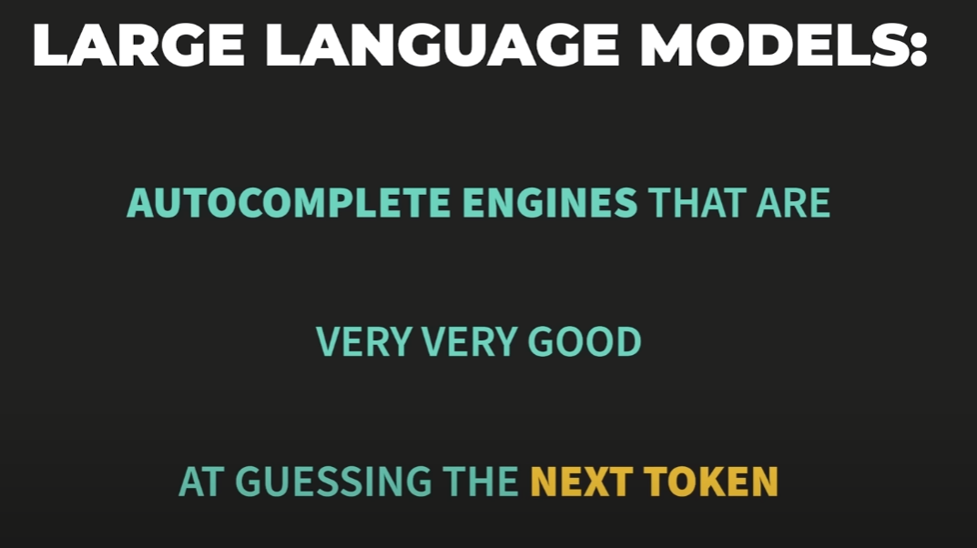

Slide 15
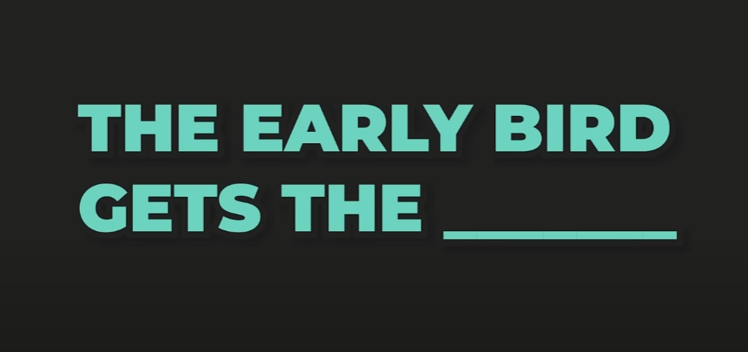

Slide 16
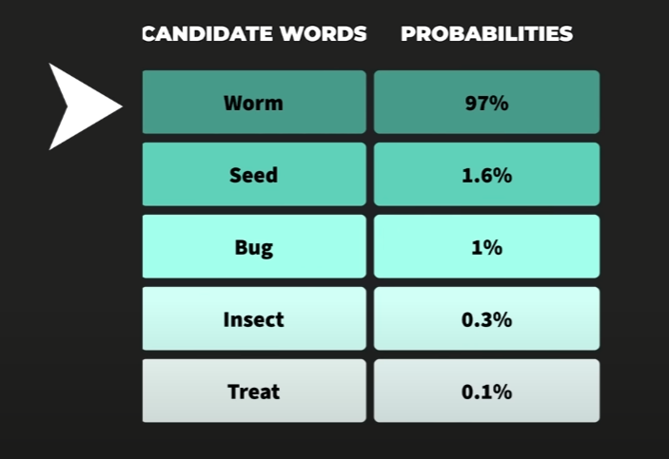

Slide 17
OpenAI API
獲得API帳號後有一個API KEY
在程式使用此帳號需要設定
使用HTTP方式來存取模型
可以訓練(微調)自己的模型
模型只能在OpenAI的雲端上，無法下載，包括自己訓練的模型
自己微調的模型使用也要收費
不是每個模型都可以微調，目前只提供到GPT4

Slide 18
OpenAI 的遊樂場
在寫程式之前先測試Prompt
有多種模式可選擇
有多種模型可選擇
多個參數可調整
可查看token數
可查看next tokens的分佈機率
有多個預設集可參考

Slide 19
專有名詞解釋
Notes:
https://www.techbang.com/posts/44430-three-laws-of-robotics-is-too-simple-google-ceo-made-ai-ten-principles

Slide 20
API參數說明
Modes
Models
Temperature
Maximum Length
Stop Sequences
Top P
Frequency/Presence Penalty
Best of
Inject Start/Restart Text
Show probabilities

Slide 21
Modes
Notes:
https://www.techbang.com/posts/44430-three-laws-of-robotics-is-too-simple-google-ceo-made-ai-ten-principles

Slide 22
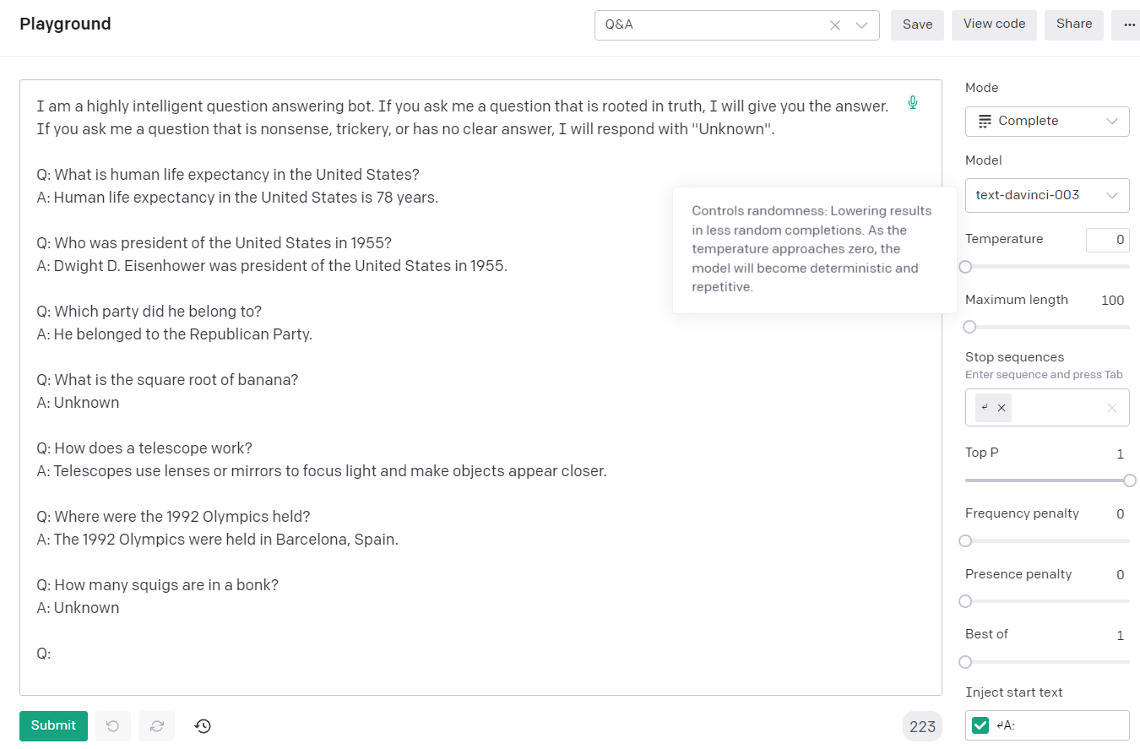
Mode: Completion

Slide 23
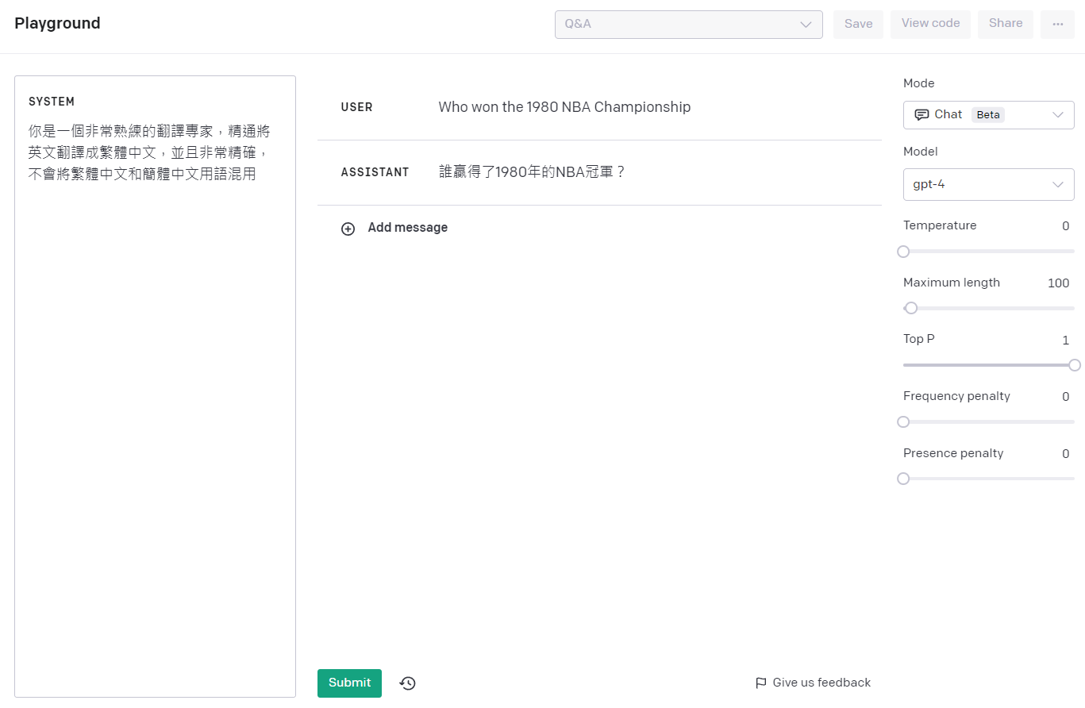
Mode: Chat

Slide 24
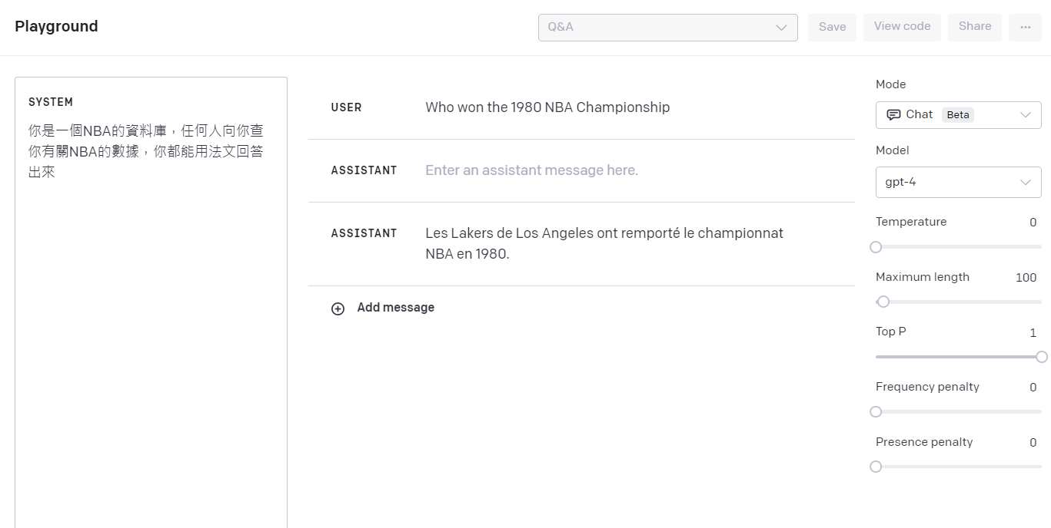
Mode: Chat

Slide 25
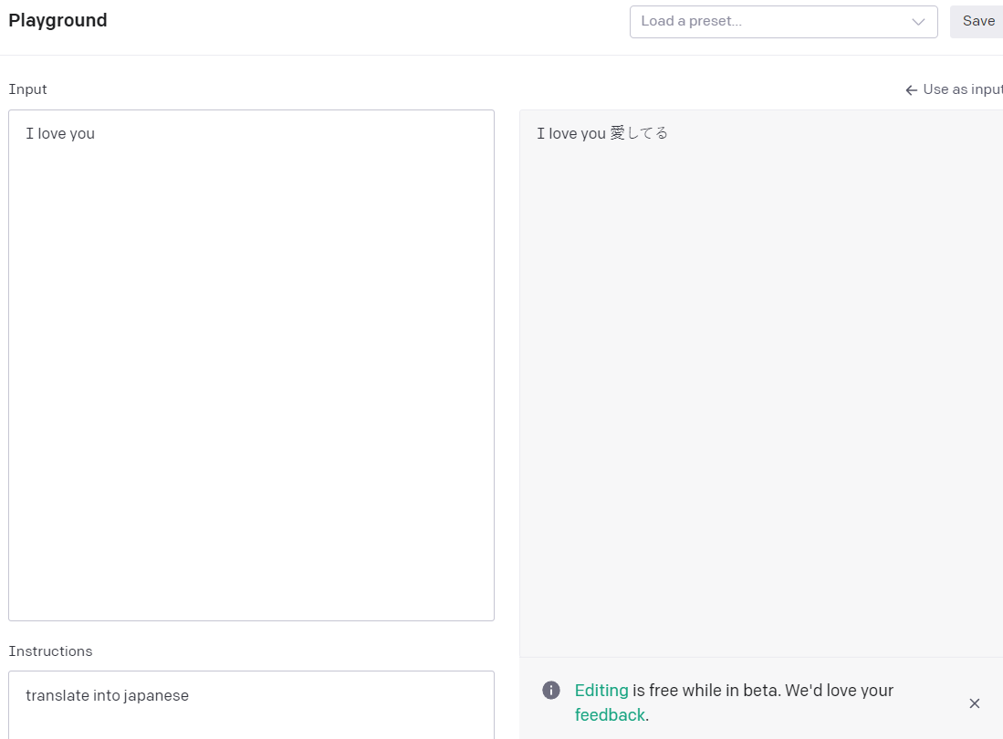
Mode: Edit

Slide 26
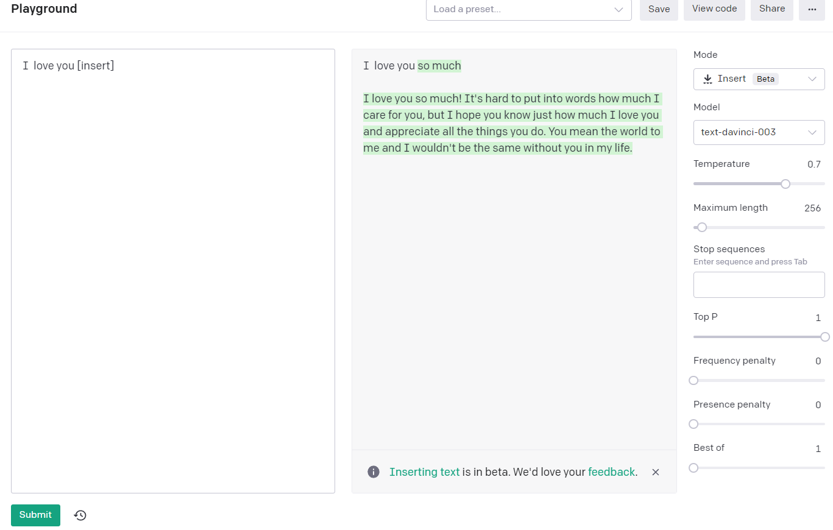
Mode: Insert

Slide 27
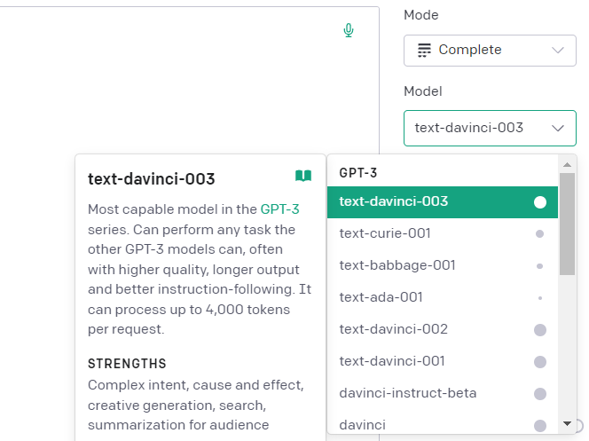
Model Selection

Slide 28
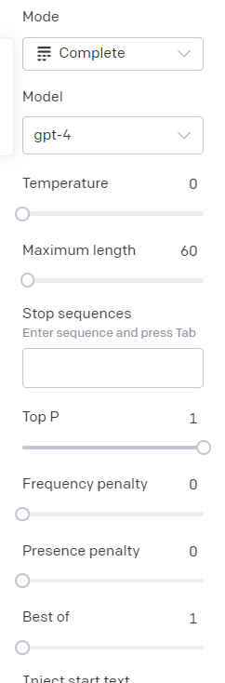
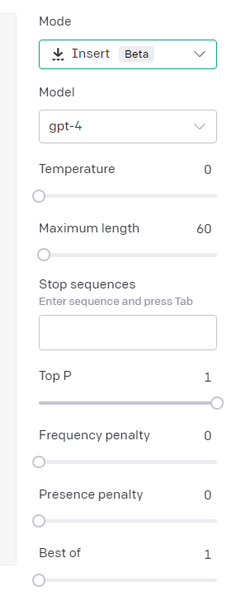
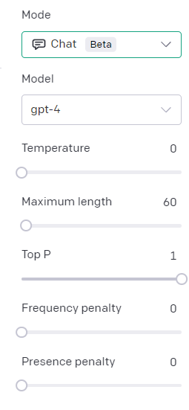
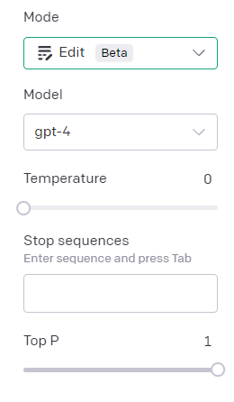

Slide 29
Models
Notes:
https://www.techbang.com/posts/44430-three-laws-of-robotics-is-too-simple-google-ceo-made-ai-ten-principles

Slide 30
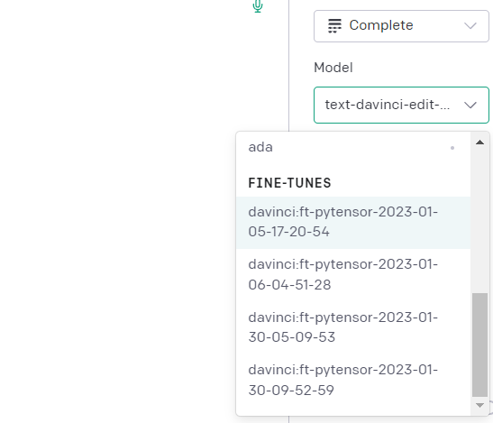
Model Selection

Slide 31
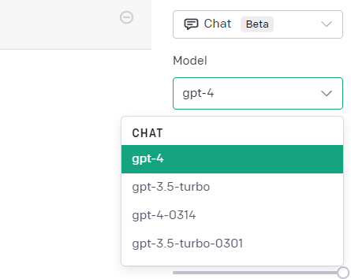
Model Selection

Slide 32
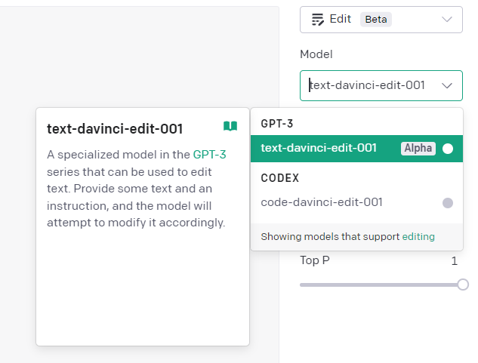
Model Selection

Slide 33
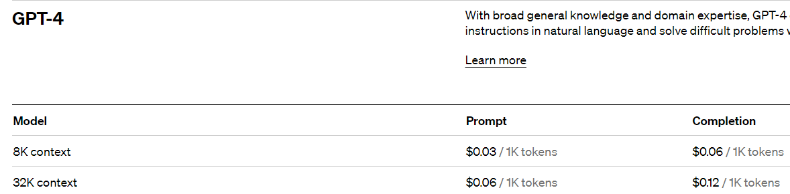
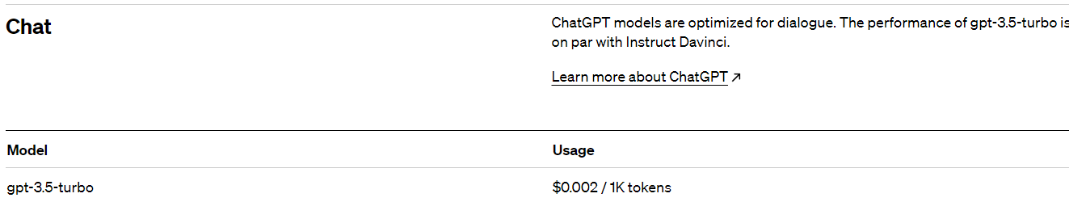

Slide 34
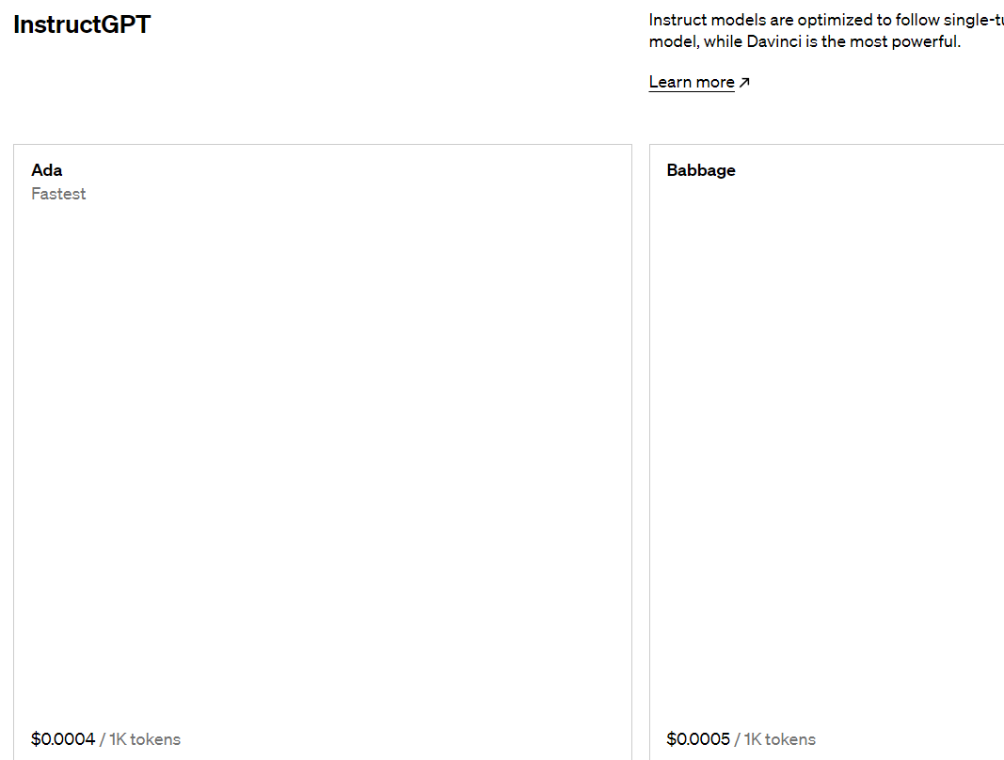

Slide 35
Temperature
Notes:
https://www.techbang.com/posts/44430-three-laws-of-robotics-is-too-simple-google-ceo-made-ai-ten-principles

Slide 36
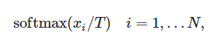
Temperature
利用熱力學熵增定律，越大時越無序
值介於0~1之間
在進入Softmax之前，每個有可能的token都會有一個logit值，是沒經過正規化的
將這個logit值除以T，就會讓logits的分佈出現變化，如果T變小，每個logits的值就會再放大，如果T變大，logits變會變小
最後再放入Softmax算出機率值
越接近1越無序，越靠近1越有序

Slide 37
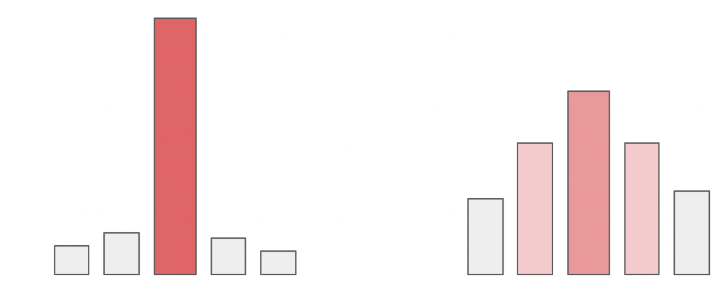

Slide 38
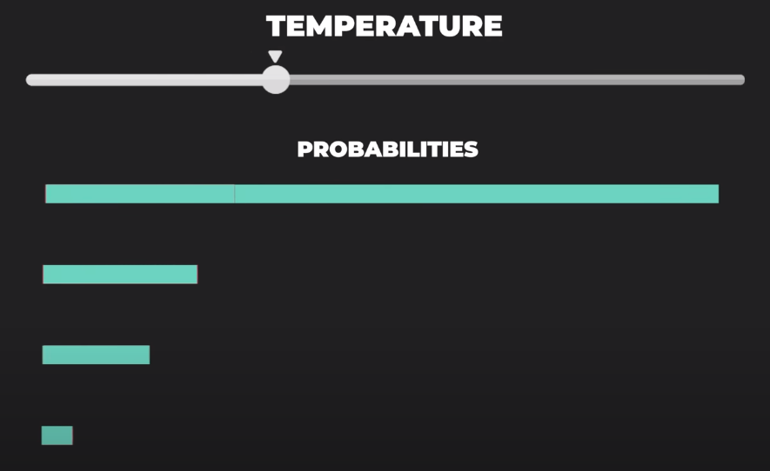

Slide 39
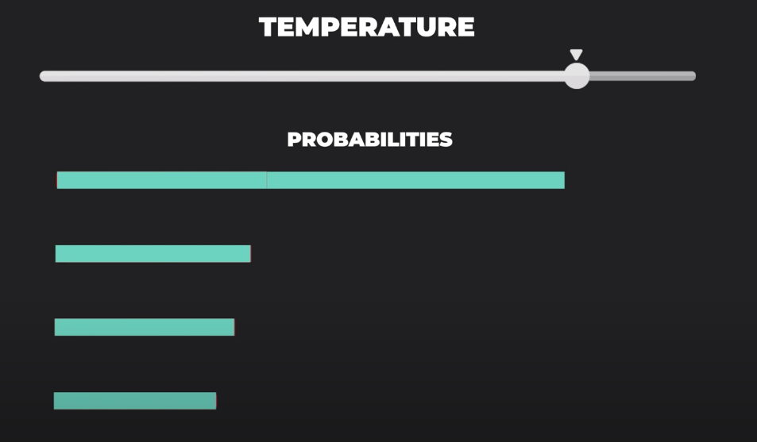

Slide 40
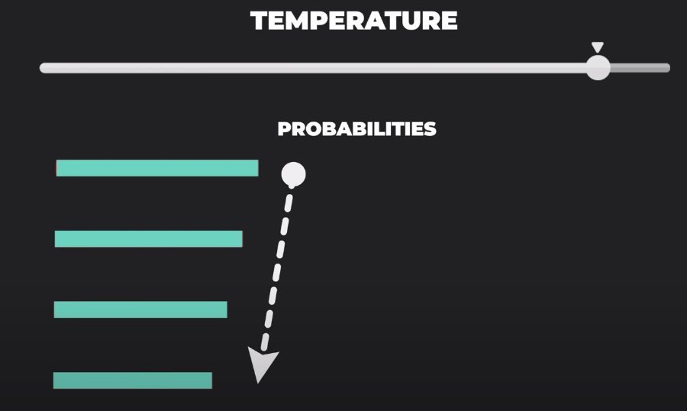

Slide 41
Temperature
Prompt範例：
「人類最好的朋友是」
用1和0，多試幾次的結果

Slide 42
最大長度
Notes:
https://www.techbang.com/posts/44430-three-laws-of-robotics-is-too-simple-google-ceo-made-ai-ten-principles

Slide 43
最大長度
Prompt和生成文字最大長度的總合
視模型而定，GPT3是2048，GPT4是4096，還有4K和8K的GPT4
單位是token
通常一個token包括4個英文字
中文大約是一個字一個token

Slide 44
停止序列
Notes:
https://www.techbang.com/posts/44430-three-laws-of-robotics-is-too-simple-google-ceo-made-ai-ten-principles

Slide 45
停止序列
遇到什麼字會停止生成，就算還沒達到最大長度
預設值是AI., Human. \n\n
可以自己設定3個值

Slide 46
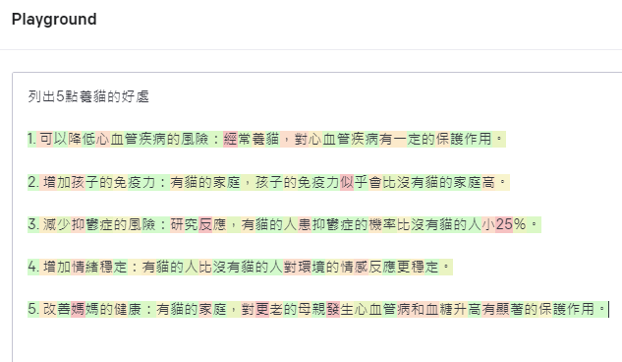

Slide 47
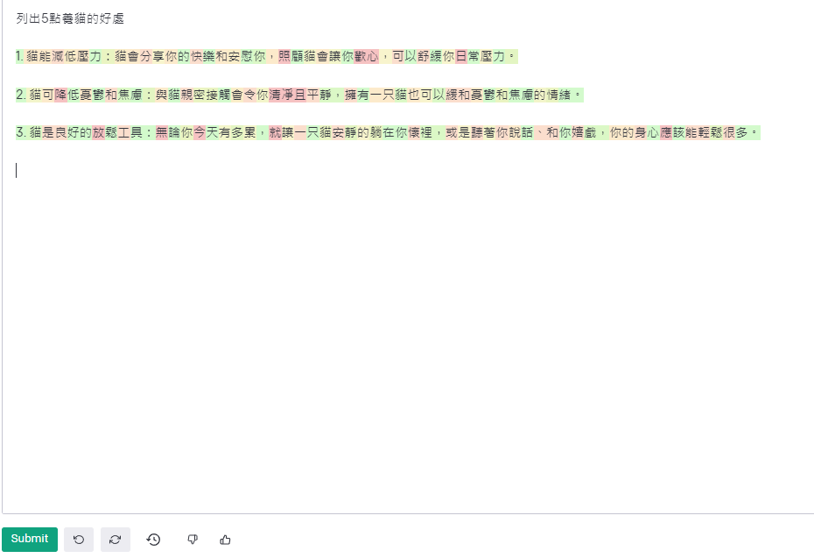
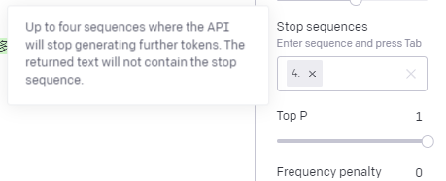

Slide 48
Top-P
Notes:
https://www.techbang.com/posts/44430-three-laws-of-robotics-is-too-simple-google-ceo-made-ai-ten-principles

Slide 49
Top-P
稱之為sampling threshold或nucleus sampling)
也是調整出現token的發散程度
通常使用時，會固定一個值，如Temperature或Top-P再調整另一個
越近接0越固定，1越亂數
使用Cumulative distribution function(CDF)累積機率分佈

Slide 50
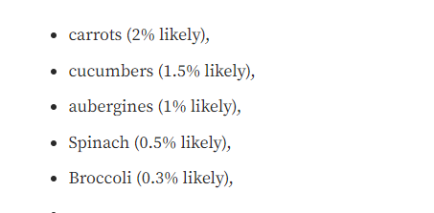
Top-P
例如：I want to eat ______
要算出P(word/I want to eat)的機率

Slide 51
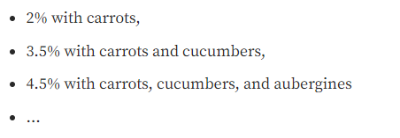
Top-P
把發生的機率相加起來
如果把top p調整2%, 3.5%, 4.5%就會選到對應不同的字的可能性

Slide 52
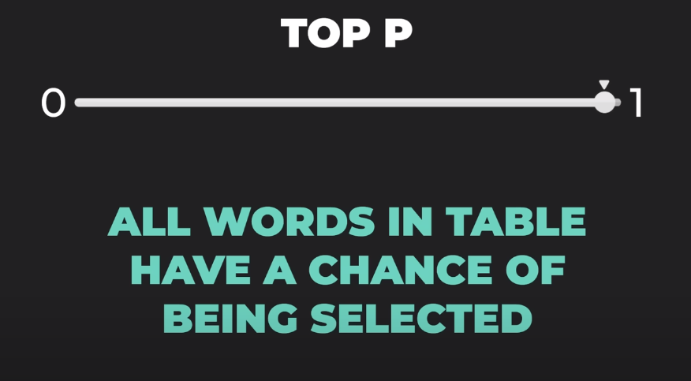

Slide 53
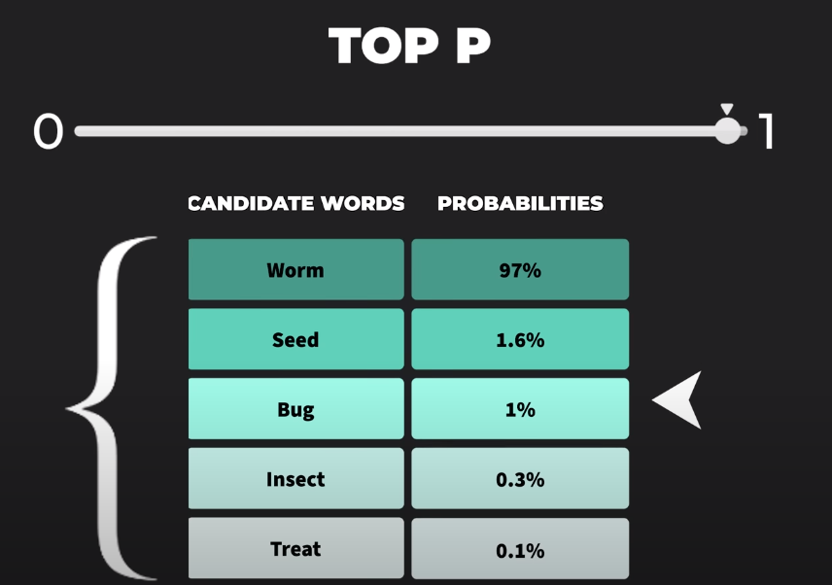

Slide 54
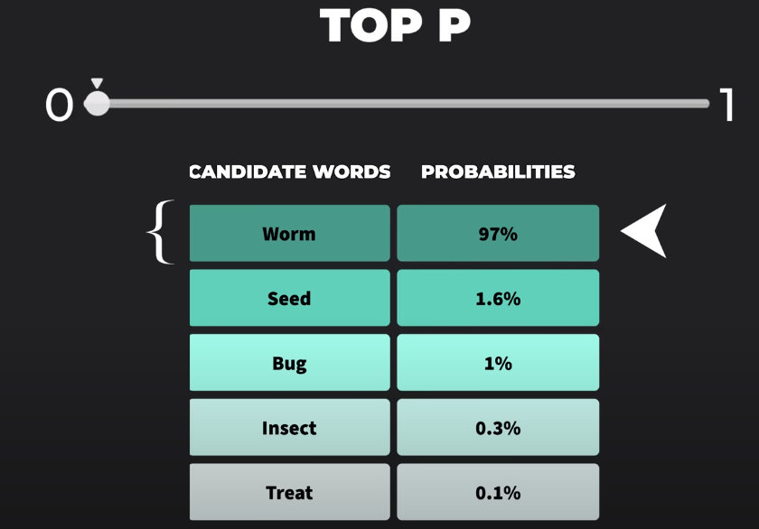

Slide 55
Penalty
Notes:
https://www.techbang.com/posts/44430-three-laws-of-robotics-is-too-simple-google-ceo-made-ai-ten-principles

Slide 56
Frequency penalty
頻率懲罰參數控制模型重複預測的趨勢
頻率懲罰降低了已經生成單詞的機率
懲罰取決於一個詞在預測中已經出現了多少次
頻率懲罰參數控制模型重複預測的趨勢。頻率懲罰降低了已經生成單詞的概率。懲罰取決於一個詞在預測中已經出現了多少次。

Slide 57
Presence penalty
存在懲罰參數鼓勵模型做出新的預測
如果某個詞已經出現在預測文字中，則存在懲罰會降低該詞的機率
與頻率懲罰不同，存在懲罰不依賴於單詞在過去預測中出現的頻率

Slide 58
Best of n
Notes:
https://www.techbang.com/posts/44430-three-laws-of-robotics-is-too-simple-google-ceo-made-ai-ten-principles

Slide 59
Best of n
模型會在伺服器端生成多個答案，並且選擇n個最適當的值顯示
如果設太大，就會大量生成文字，會讓費用暴增
平常就設1，因為生成的答案應該已經是最好的答案了

Slide 60
前綴後綴
Notes:
https://www.techbang.com/posts/44430-three-laws-of-robotics-is-too-simple-google-ceo-made-ai-ten-principles

Slide 61
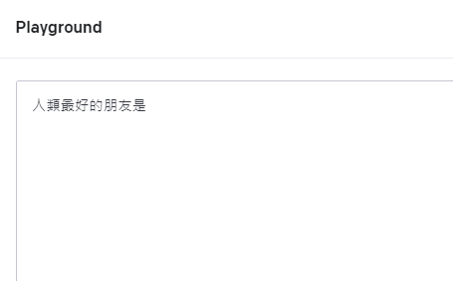
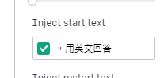
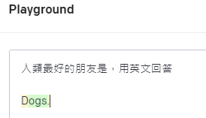
Inject Start/Restart text
Start：在提問後面自動接上的字

Slide 62
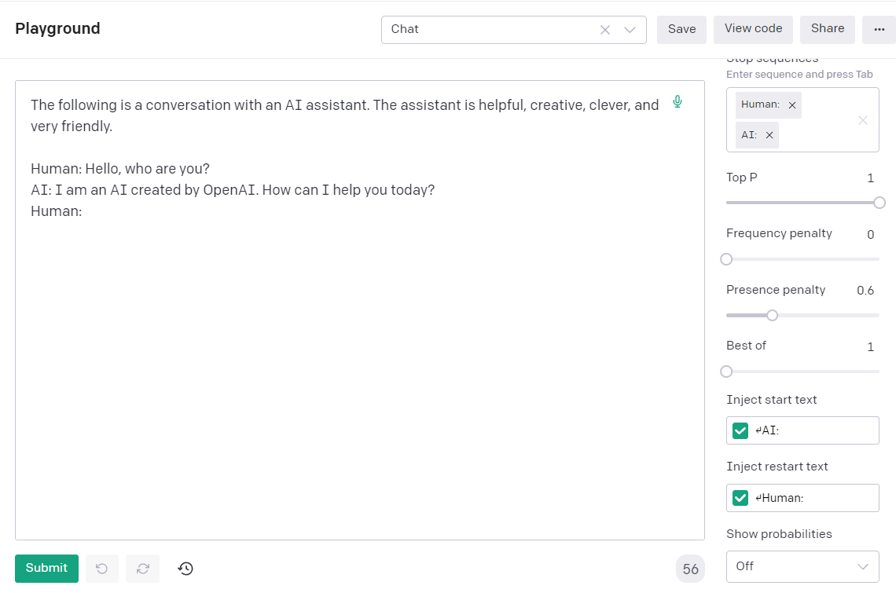
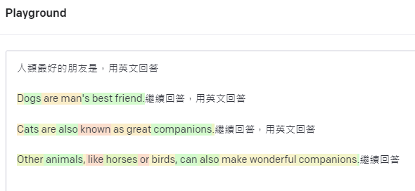
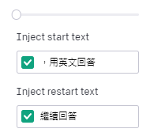

Slide 63
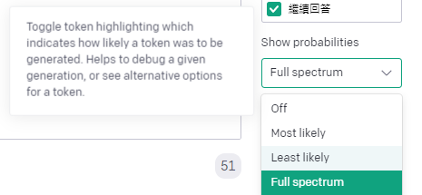
顯示產生文字的機率

Slide 64
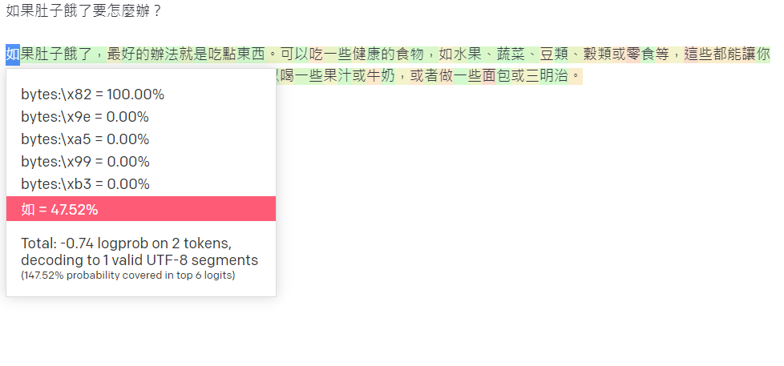

Slide 65
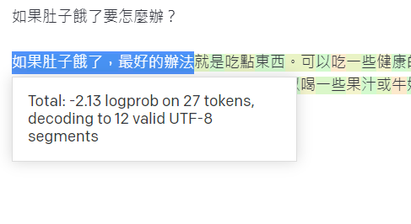

Slide 66
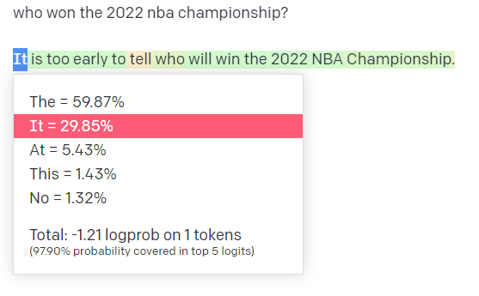

Slide 67
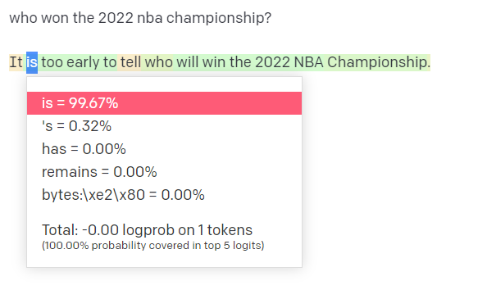

Slide 68
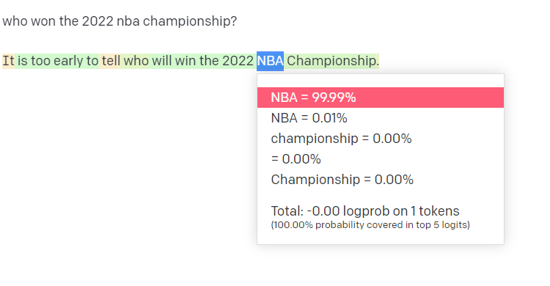

Slide 69
Prompt原則
Notes:
https://www.techbang.com/posts/44430-three-laws-of-robotics-is-too-simple-google-ceo-made-ai-ten-principles

Slide 70
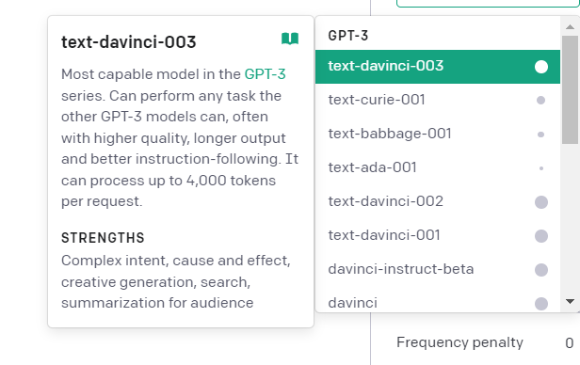
使用最新的模型

Slide 71

使用分隔符號

Slide 72
使用精確長文字
介紹一下明新科大
用500字繁體中文介紹明新科技大學，這是一個在台灣新竹縣新豐鄉的大學，避免冗長的文字，用列點式介紹，不要使用官方文字：

Slide 73
使用範例格式
提取下面文字中的命名實體類型：公司名稱、人名、特定抬頭及主題
提取下面文字中提到的重要實體。首先提取所有公司名稱，然後提取所有人員姓名，然後提取適合內容的特定主題，最後提取一般總體主題所需
格式：
公司名稱：<comma_separated_list_of_company_names>
人員名稱：-||-
特定主題：-||-
一般主題：-||-
文本：{text}

Slide 74
避免太多形容詞
用簡短幾句話描述這個產品，不要太多字
用3-5個句子的段落描述下列文字提到的產品

Slide 75
避免「不要做什麼」
The following is a conversation between an Agent and a Customer. DO NOT ASK USERNAME OR PASSWORD. DO NOT REPEAT.
Customer: I can't log in to my account.
Agent:
The following is a conversation between an Agent and a Customer. The agent will attempt to diagnose the problem and suggest a solution, whilst refraining from asking any questions related to PII. Instead of asking for PII, such as username or password, refer the user to the help article www.samplewebsite.com/help/faq
Customer: I can't log in to my account.
Agent:

Slide 76
給模型一個小提示
# Write a simple python function that
# 1. Ask me for a number in mile
# 2. It converts miles to kilometers
# Write a simple python function that
# 1. Ask me for a number in mile
# 2. It converts miles to kilometers
import

Slide 77
Prompt完整格式
Notes:
https://www.techbang.com/posts/44430-three-laws-of-robotics-is-too-simple-google-ceo-made-ai-ten-principles

Slide 78


Slide 79


Slide 80


Slide 81


Slide 82


Slide 83


Slide 84


Slide 85


Slide 86


Slide 87


Slide 88
進階Prompt工程
Notes:
https://www.techbang.com/posts/44430-three-laws-of-robotics-is-too-simple-google-ceo-made-ai-ten-principles

Slide 89
進階prompt工程
Zero-shot Prompting
Few-shot Prompting
Chain-of-Thought Prompting
Self-Consistency
Generate Knowledge Prompting
Automatic Prompt Engineer
Active-Prompt
Directional Stimulus Prompting
ReAct
Multimodal CoT
Graph Prompting

Slide 90
再探zero-shot
ChatGPT使用了人類老師RLHF（來自人類反饋的強化學習）
模型被調整以更好地適應人類偏好
語言模型已經大概知道人類世界知識，並且由人類老師幫忙教導
如果真的無樣本，可利用上一小節的5大元素來給模型完整的提示

Slide 91
Few shot提示
Zero-shot時，偏重於instruction learning
如果有樣本時，偏向in-context learning
不只是從內容中學習，會從我們的「模式」中學習
就算是錯誤答案也會給出「正確」的方向
下面是one-shot

Slide 92


Slide 93


Slide 94

Few shot提示
如果一直出錯，要多給幾個shot

Slide 95
Few shot提示
如果一直出錯，要多給幾個shot

Slide 96


Slide 97
Chain of Thoughts
將問題拆解成更小的問題和答案
讓模型多花點步驟和邏輯去產生正確答案
這些小的步驟和答案都必須正確

Slide 98


Slide 99


Slide 100
Chain of Thoughts
Prompt:
The odd numbers in this group add up to an even number: 4, 8, 9, 15, 12, 2, 1.
A: Adding all the odd numbers (9, 15, 1) gives 25. The answer is False.
The odd numbers in this group add up to an even number: 17, 10, 19, 4, 8, 12, 24.
A: Adding all the odd numbers (17, 19) gives 36. The answer is True.
The odd numbers in this group add up to an even number: 16, 11, 14, 4, 8, 13, 24.
A: Adding all the odd numbers (11, 13) gives 24. The answer is True.
The odd numbers in this group add up to an even number: 17, 9, 10, 12, 13, 4, 2.
A: Adding all the odd numbers (17, 9, 13) gives 39. The answer is False.
The odd numbers in this group add up to an even number: 15, 32, 5, 13, 82, 7, 1.
A:
Output:
Adding all the odd numbers (15, 5, 13, 7, 1) gives 41. The answer is False.

Slide 101


Slide 102
Chain of Thoughts
Prompt:
The odd numbers in this group add up to an even number: 4, 8, 9, 15, 12, 2, 1.
A: Adding all the odd numbers (9, 15, 1) gives 25. The answer is False.
The odd numbers in this group add up to an even number: 15, 32, 5, 13, 82, 7, 1.
A:
Output:
Adding all the odd numbers (15, 5, 13, 7, 1) gives 41. The answer is False.

Slide 103


Slide 104


Slide 105


Slide 106
自我一致性
用同一個Prompt產生出多個不同的答案，然後把最常出現的答案視為正確

Slide 107
自我一致性
Q: There are 15 trees in the grove. Grove workers will plant trees in the grove today. After they are done,there will be 21 trees. How many trees did the grove workers plant today?A: We start with 15 trees. Later we have 21 trees. The difference must be the number of trees they planted.So, they must have planted 21 - 15 = 6 trees. The answer is 6.Q: If there are 3 cars in the parking lot and 2 more cars arrive, how many cars are in the parking lot?A: There are 3 cars in the parking lot already. 2 more arrive. Now there are 3 + 2 = 5 cars. The answer is 5.Q: Leah had 32 chocolates and her sister had 42. If they ate 35, how many pieces do they have left in total?A: Leah had 32 chocolates and Leah’s sister had 42. That means there were originally 32 + 42 = 74chocolates. 35 have been eaten. So in total they still have 74 - 35 = 39 chocolates. The answer is 39.Q: Jason had 20 lollipops. He gave Denny some lollipops. Now Jason has 12 lollipops. How many lollipopsdid Jason give to Denny?A: Jason had 20 lollipops. Since he only has 12 now, he must have given the rest to Denny. The number oflollipops he has given to Denny must have been 20 - 12 = 8 lollipops. The answer is 8.Q: Shawn has five toys. For Christmas, he got two toys each from his mom and dad. How many toys doeshe have now?A: He has 5 toys. He got 2 from mom, so after that he has 5 + 2 = 7 toys. Then he got 2 more from dad, soin total he has 7 + 2 = 9 toys. The answer is 9.Q: There were nine computers in the server room. Five more computers were installed each day, frommonday to thursday. How many computers are now in the server room?A: There are 4 days from monday to thursday. 5 computers were added each day. That means in total 4 * 5 =20 computers were added. There were 9 computers in the beginning, so now there are 9 + 20 = 29 computers.The answer is 29.Q: Michael had 58 golf balls. On tuesday, he lost 23 golf balls. On wednesday, he lost 2 more. How manygolf balls did he have at the end of wednesday?A: Michael initially had 58 balls. He lost 23 on Tuesday, so after that he has 58 - 23 = 35 balls. OnWednesday he lost 2 more so now he has 35 - 2 = 33 balls. The answer is 33.Q: Olivia has $23. She bought five bagels for $3 each. How much money does she have left?A: She bought 5 bagels for $3 each. This means she spent 5Q: When I was 6 my sister was half my age. Now I’m 70 how old is my sister?A:

Slide 108
產生常識的提示語
模型是否也可以用於在進行預測之前生成知識
生成知識以用作提示的一部分。特別是，這對常識推理等任務有多大幫助

